Slide 1
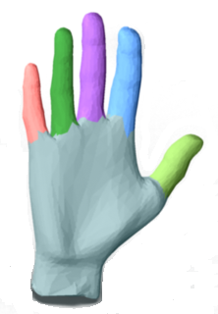
Shape Segmentation by Approximate Convexity Analysis
Oliver van Kaick, Noa Fish, Yanir Kleiman, Shmuel Asafi, and Daniel Cohen-Or
Tel Aviv University

Slide 2
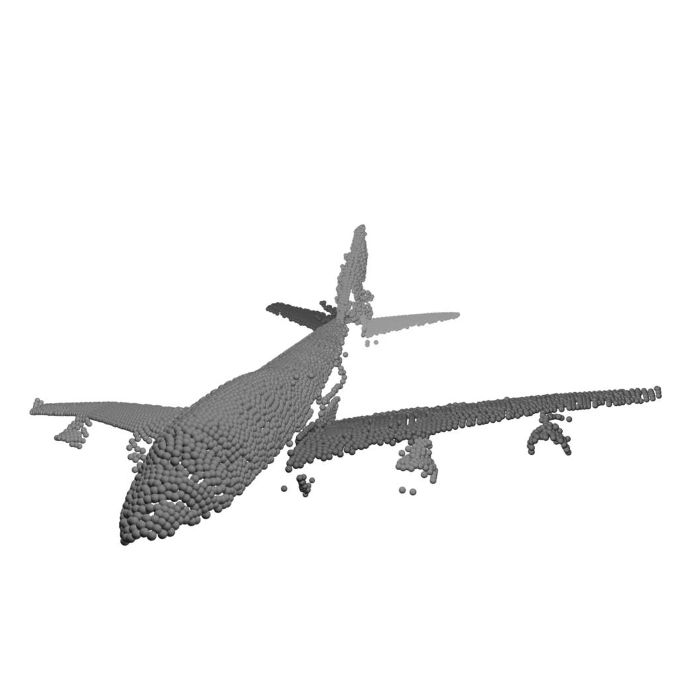
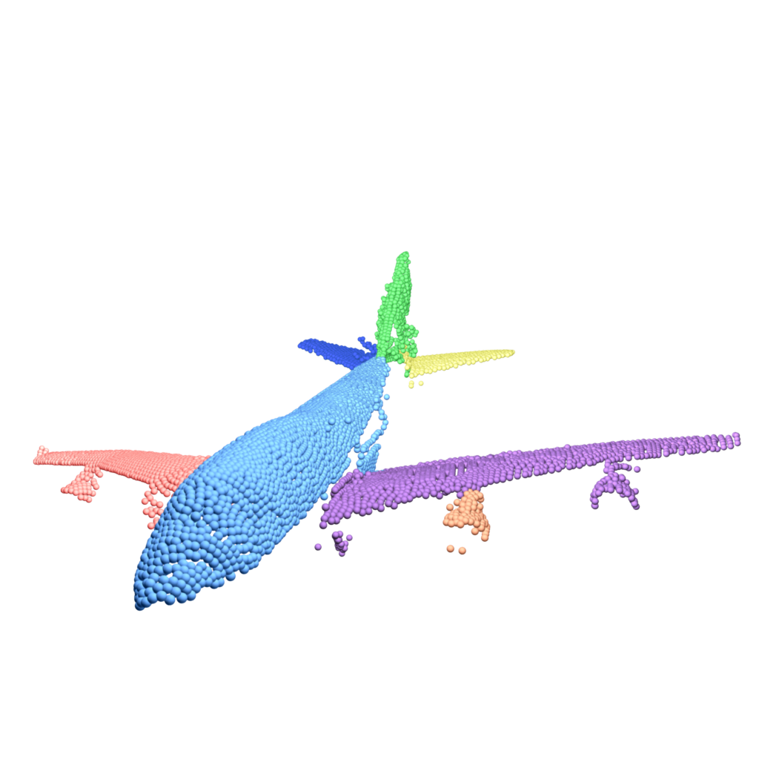
Problem
Segmentation of point clouds in semantic parts

Slide 3
Related Work
Mesh Segmentation:
(Parametric) Randomized Cuts [Golovinskiy and Funkhouser 2008]
(Non-Parametric) Concavity-Aware Fields [Au et al. 2012]
Point Clouds: (Completion) Primitive Fitting [Lafarge et al. 2013]
Machine Learning: (Co-, Joint, Supervised) Segmentation
Convex Decomposition: Weakly convex components [Asafi 2013]

Slide 4
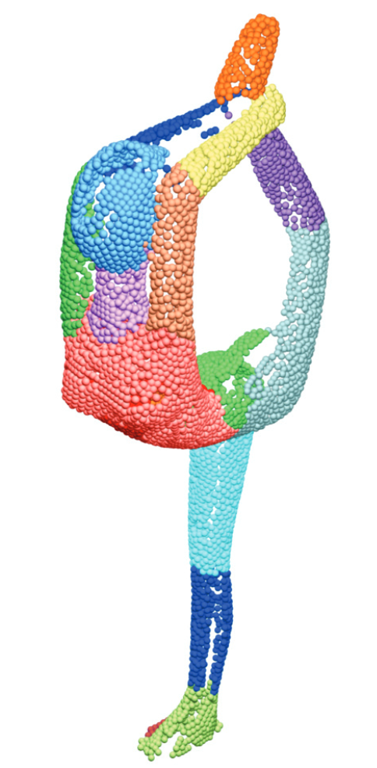
Contribution
Non-Parametric segmentation
Incomplete orientated point-clouds
No intermediate representations
“Part boundaries are perceived at the concavities of shape”
[Hoffman and Richards 1984]
Weak Convexity
+
Volumetric Profile

Slide 5
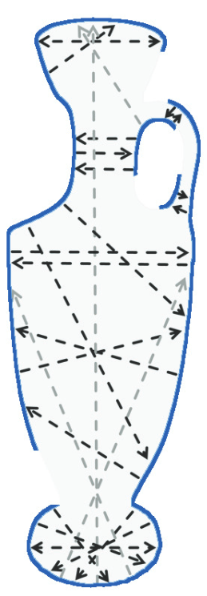
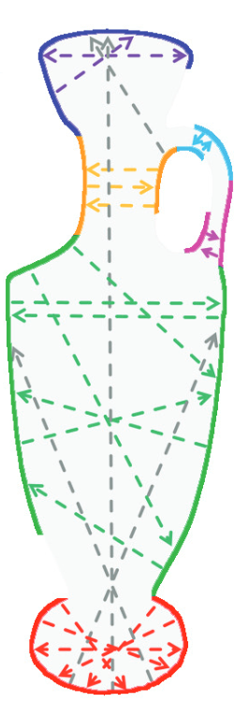
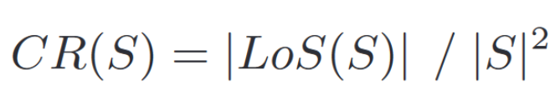
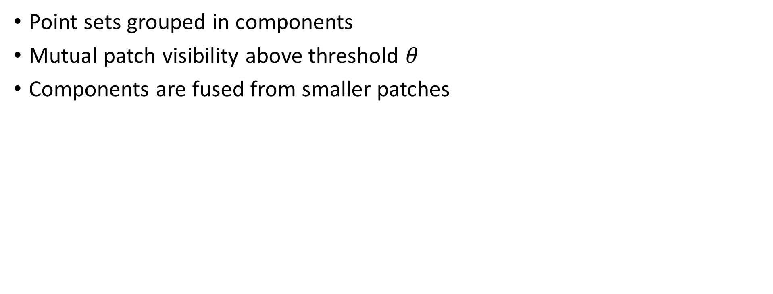
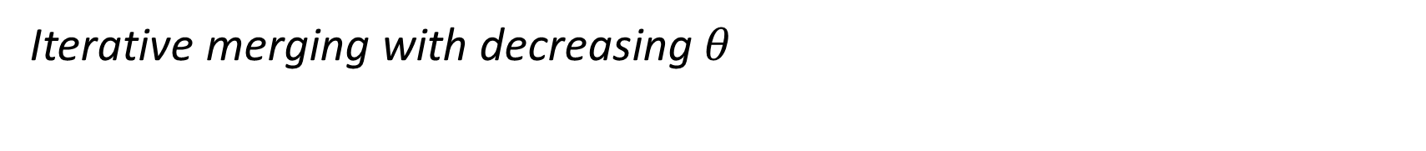
Step: Weakly Convex Regions
Point sets grouped in components
Mutual patch visibility above threshold $θ$
Components are fused from smaller patches
Iterative merging with decreasing $θ$

Slide 6
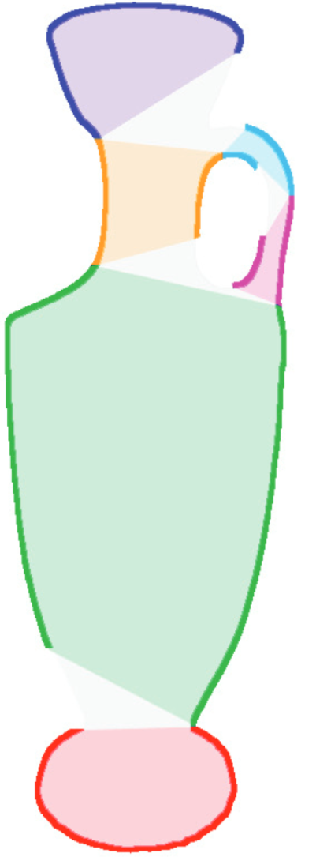
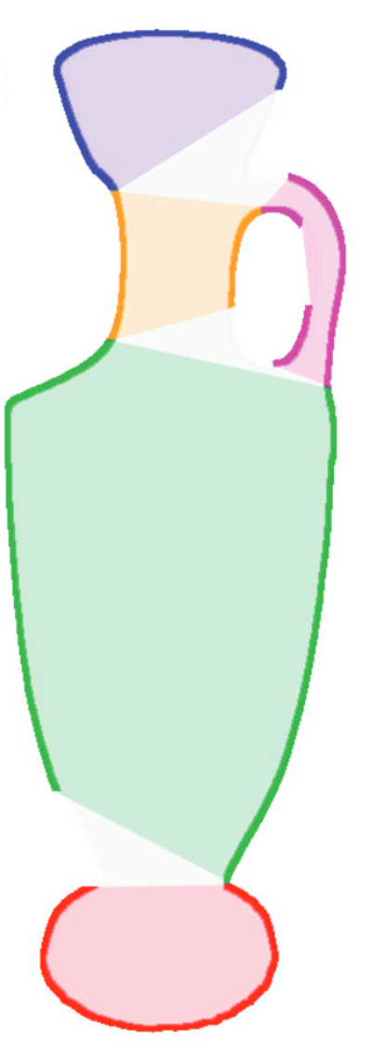
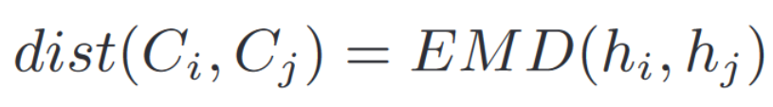
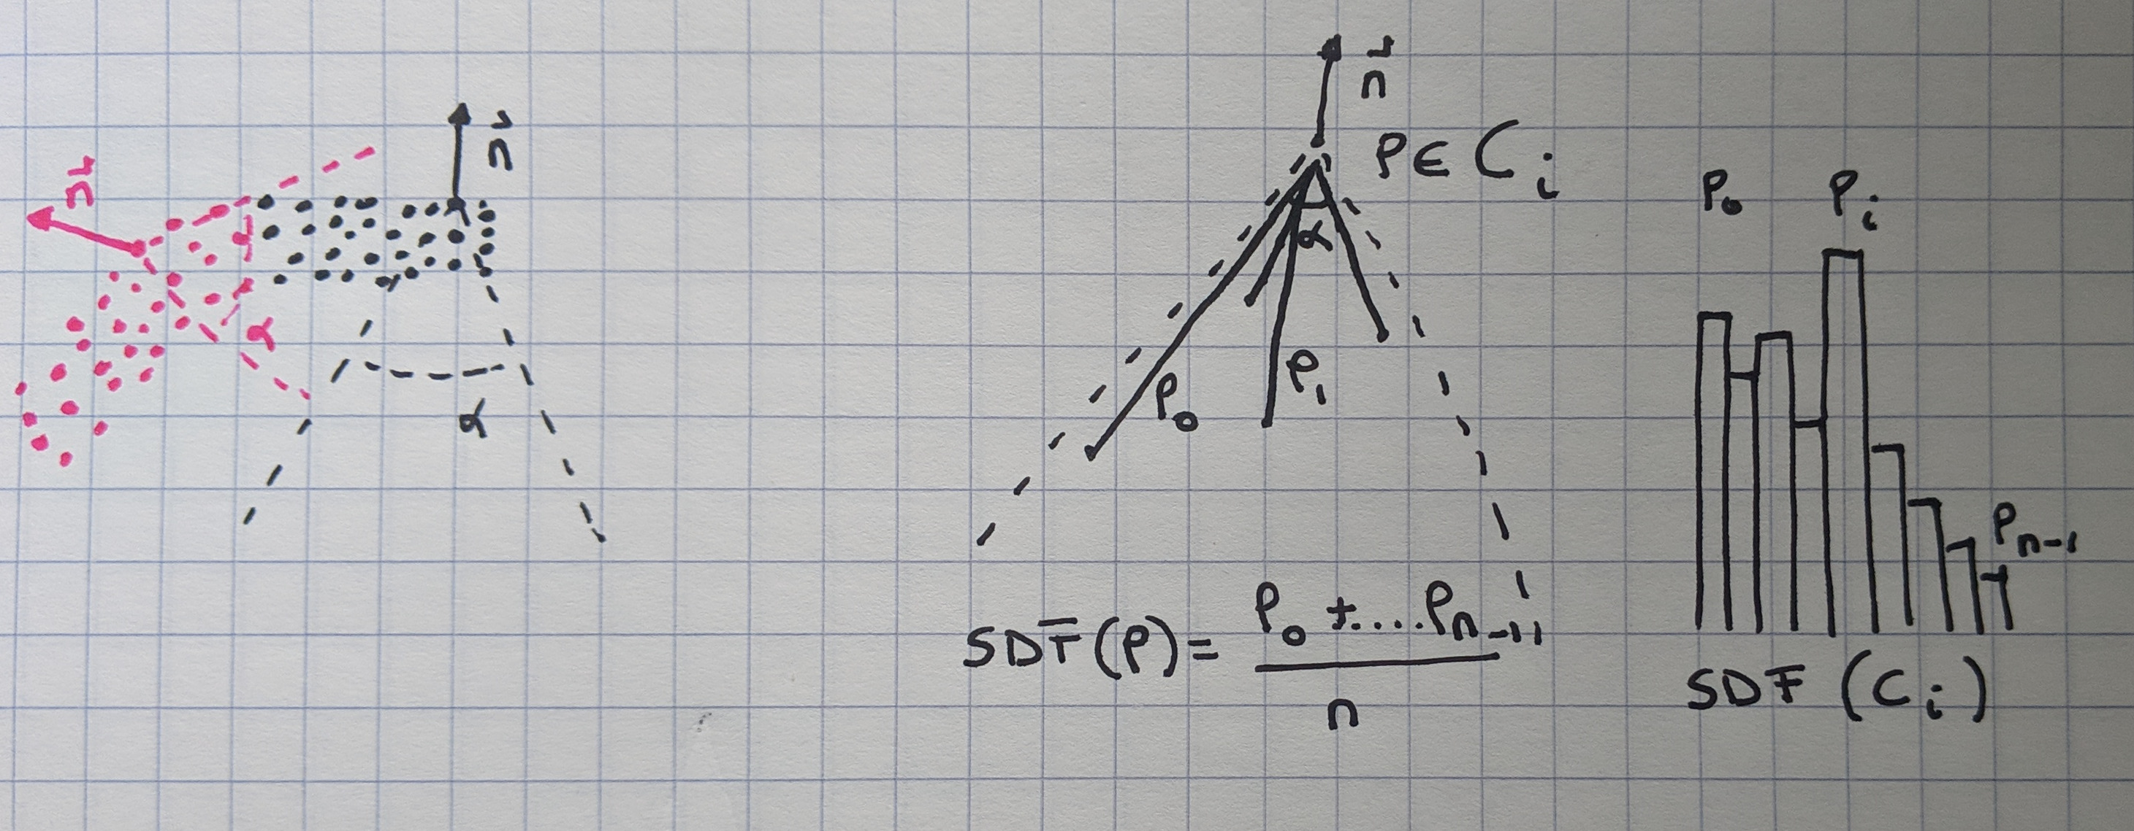
Step: Volumetric Profile
Component points contribute an SDF value
Volumetric signature is the histogram of SDF
Pairwise dissimilarity between distributions
Convexity seams included

Slide 7
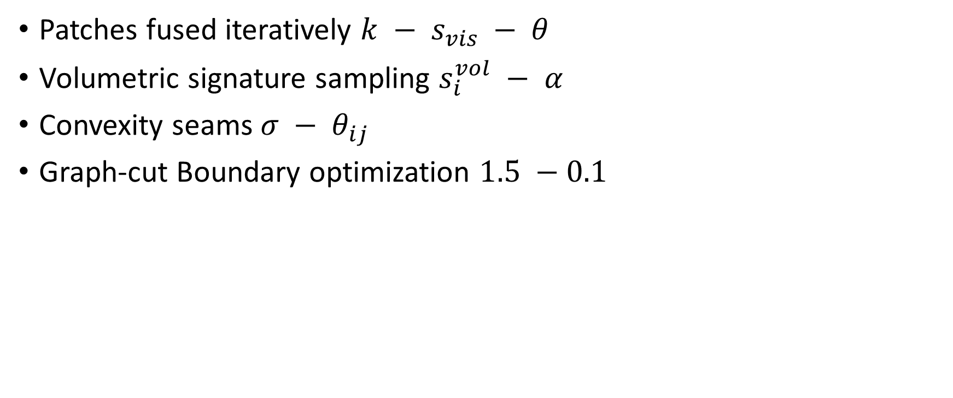
Some non-parametric details
Patches fused iteratively $k − s_{vis} − θ$
Volumetric signature sampling $s_{i}^{vol} − α$
Convexity seams $σ − θ_{ij}$
Graph-cut Boundary optimization $1.5 −0.1$

Slide 8
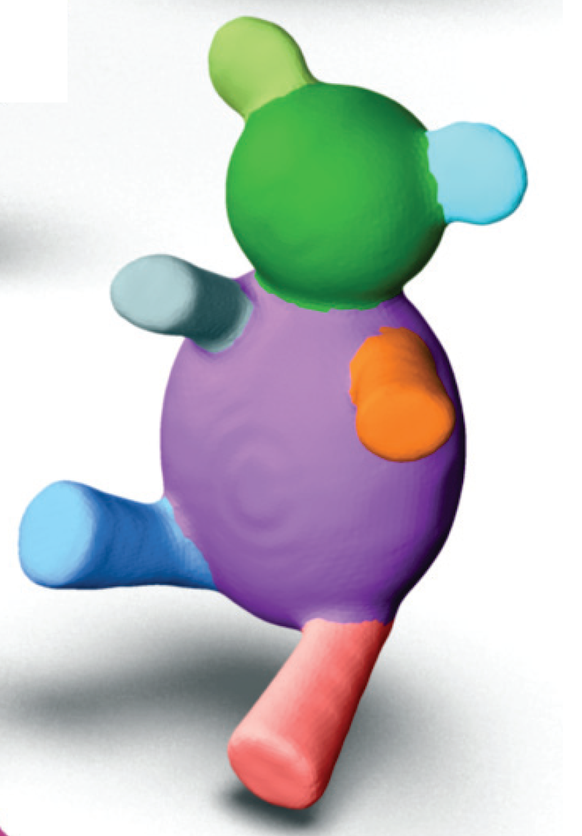
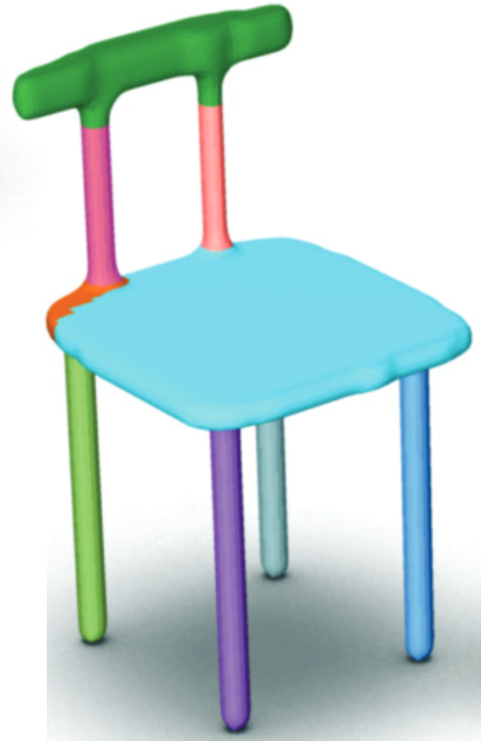
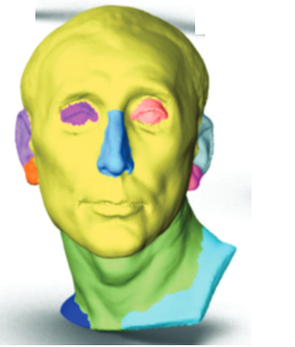
Results

Slide 9


Slide 10


Slide 11
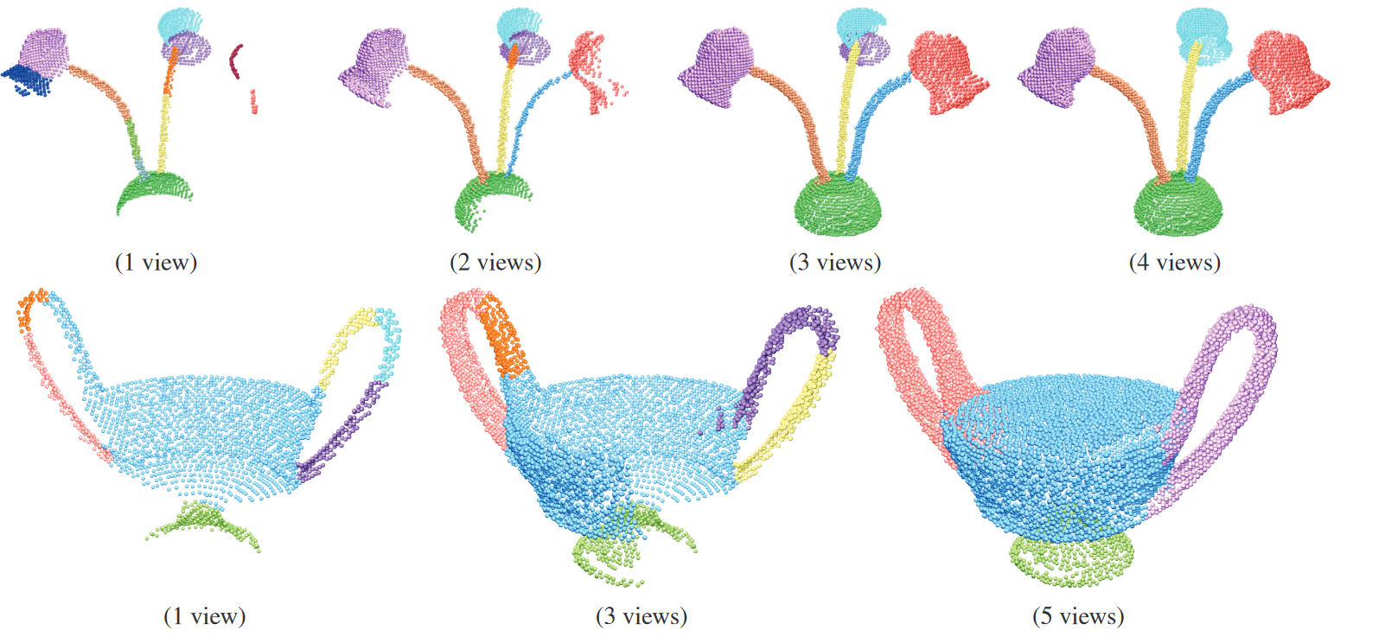

Slide 12
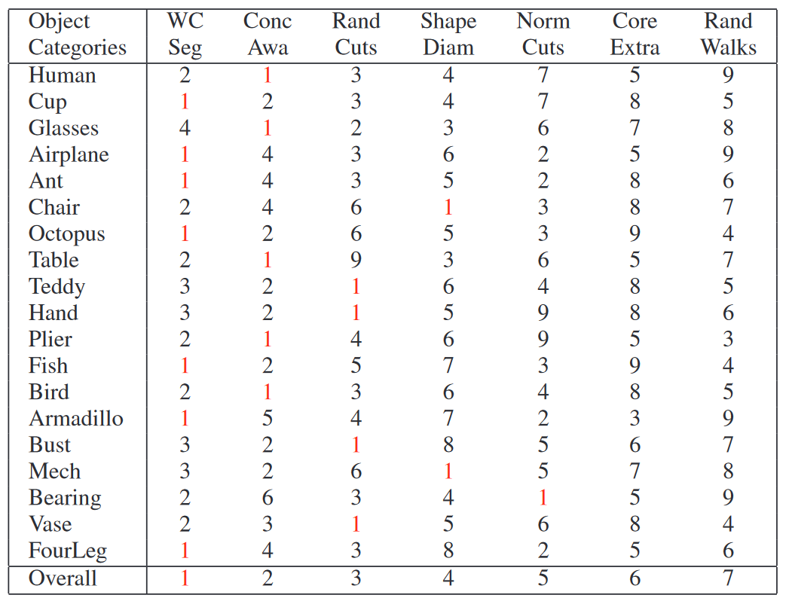
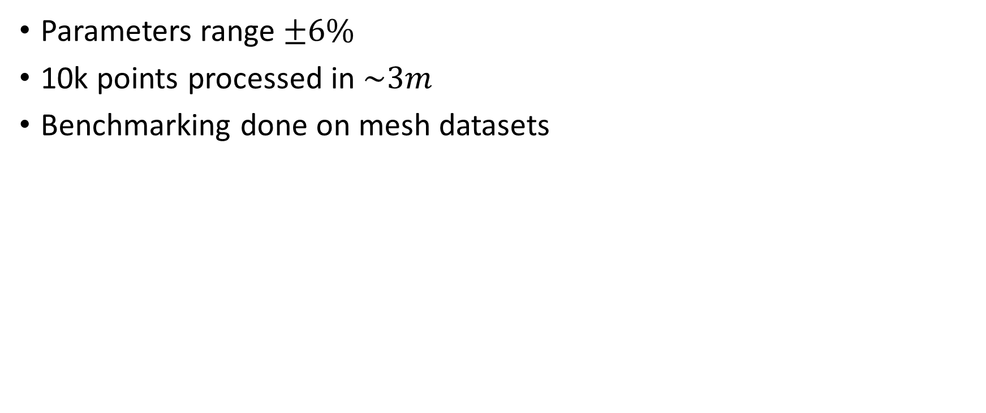
Results
Parameters range $±6\%$
10k points processed in $\sim 3m$
Benchmarking done on mesh datasets

Slide 13
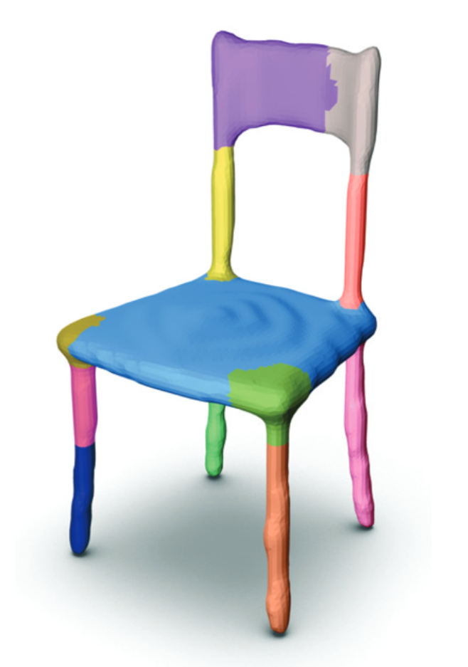
Limitations
Semantic parts with concavities are segmented
Lack of data impacts volumetric profile
Thin structures have low internal visibility
Heuristic approach requires good parameters

Slide 14
Thank you!

